Slide 1
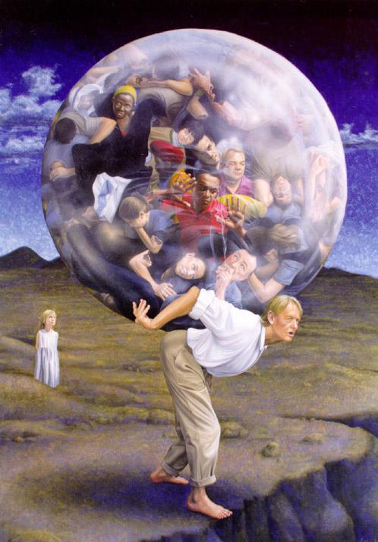
Overpopulation

Slide 2


Slide 3
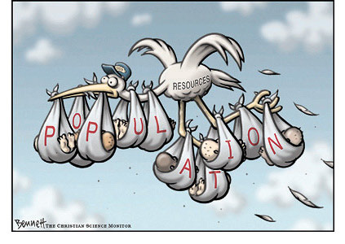

Slide 4
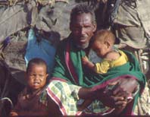
Developing countries account for more than 90-95% of today’s population growth.

Slide 5

What are some problems that arise when overpopulation occurs?
Health / Disease
Income/Poverty
Natural Resources
Older Population
Urbanization
Transportation
Deforestation
Environment
Education
Employment
Family Planning
Famine

Slide 6
Deforestation

Slide 7
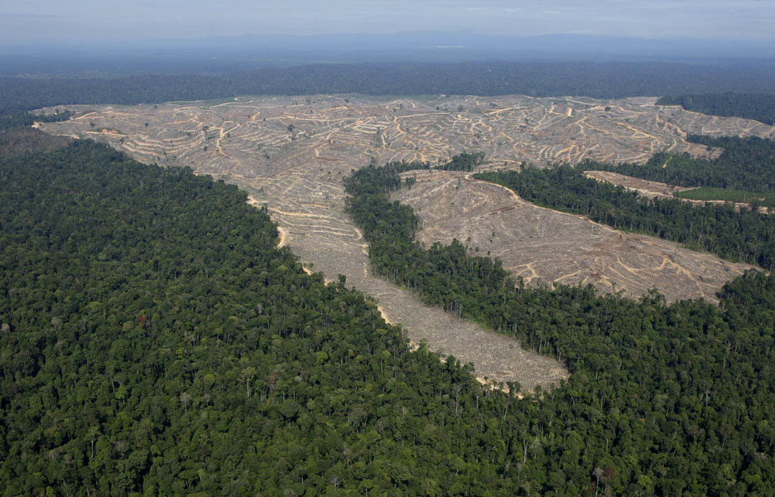

Slide 8
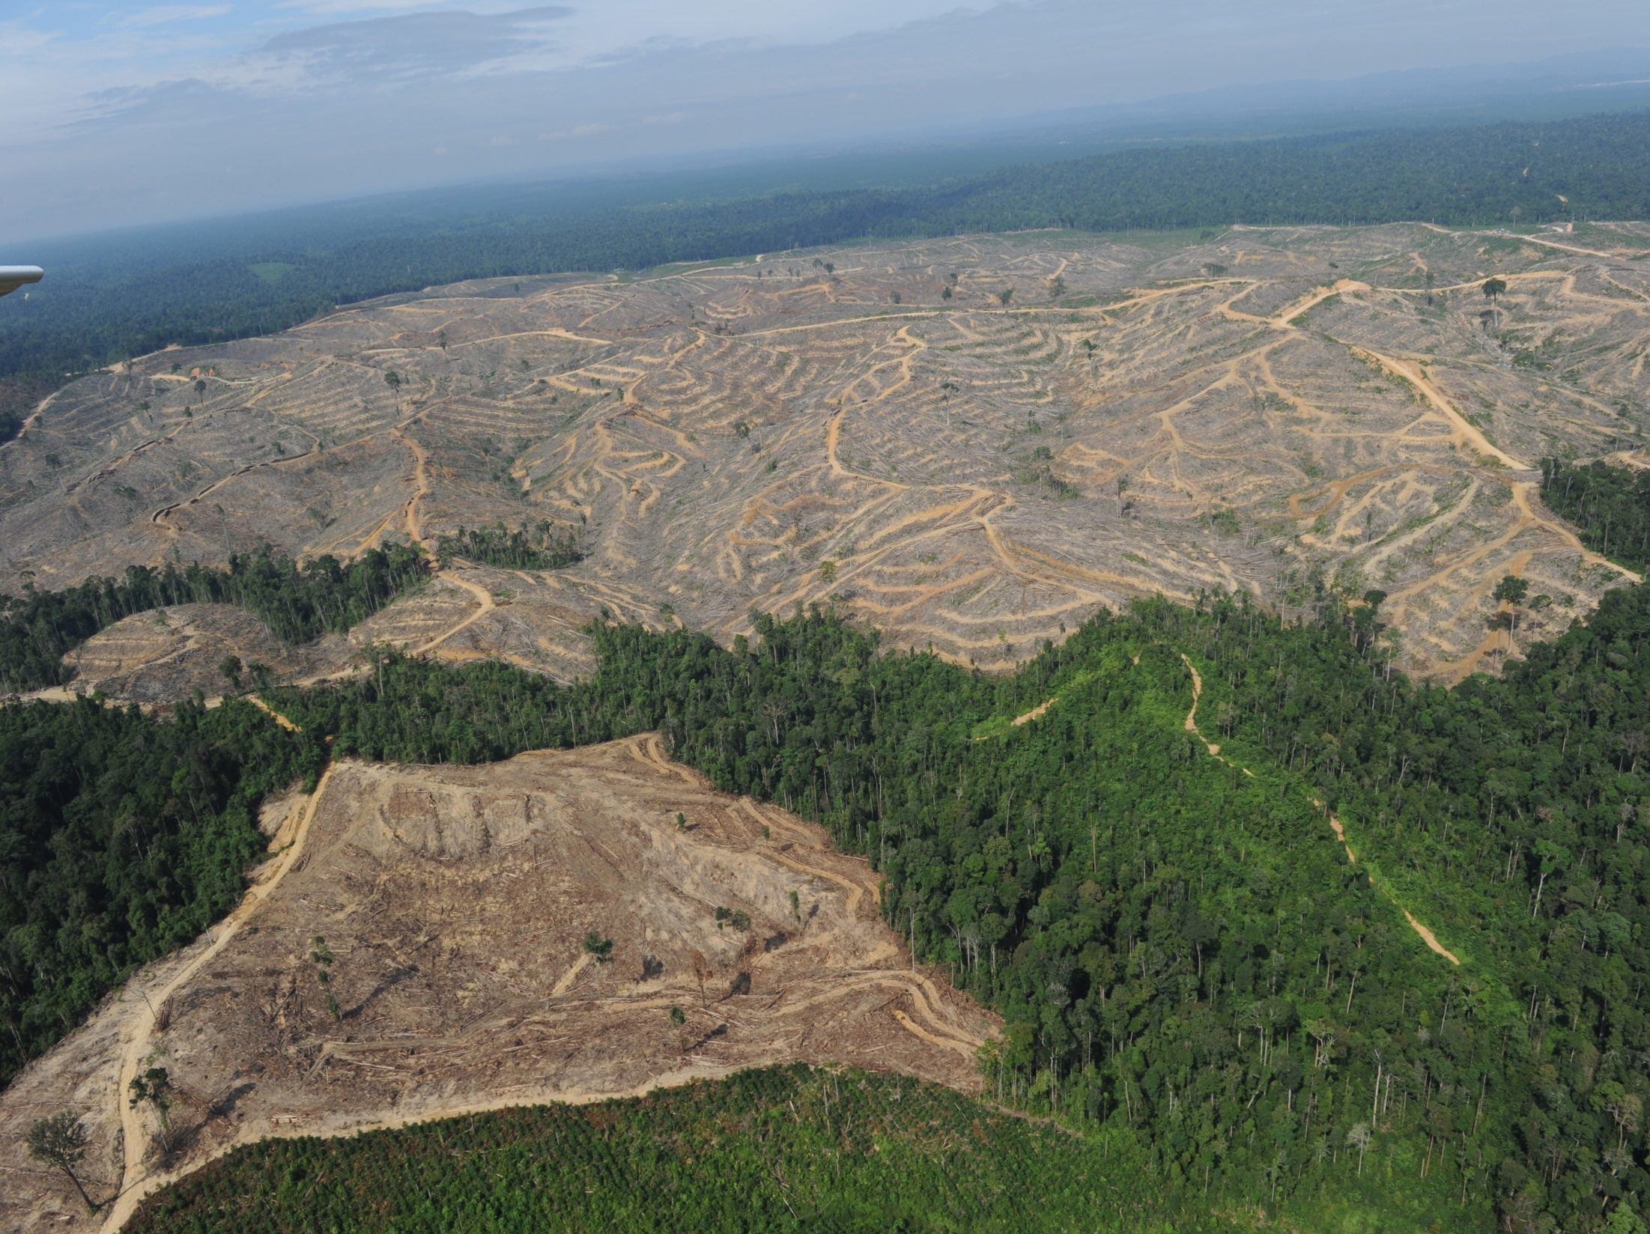

Slide 9
Education

Slide 10


Slide 11
Employment

Slide 12


Slide 13
Health / Disease

Slide 14
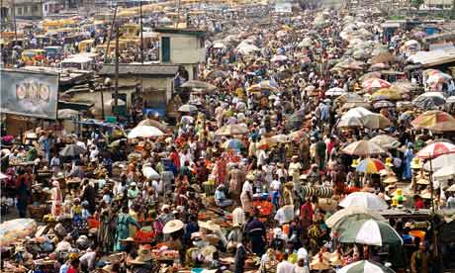

Slide 15
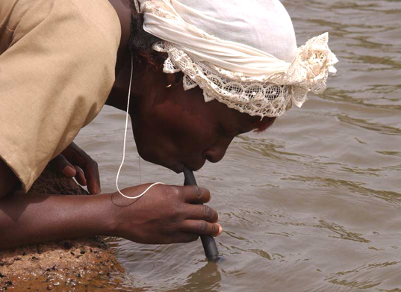

Slide 16
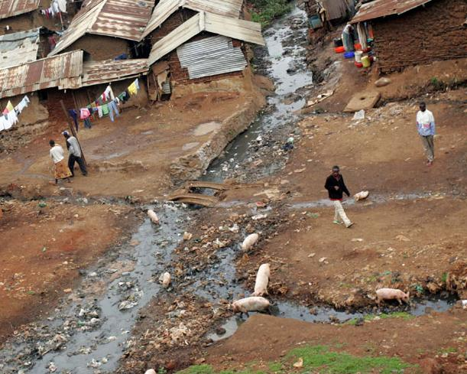

Slide 17
Income / Poverty

Slide 18
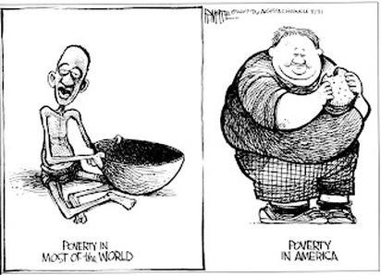

Slide 19
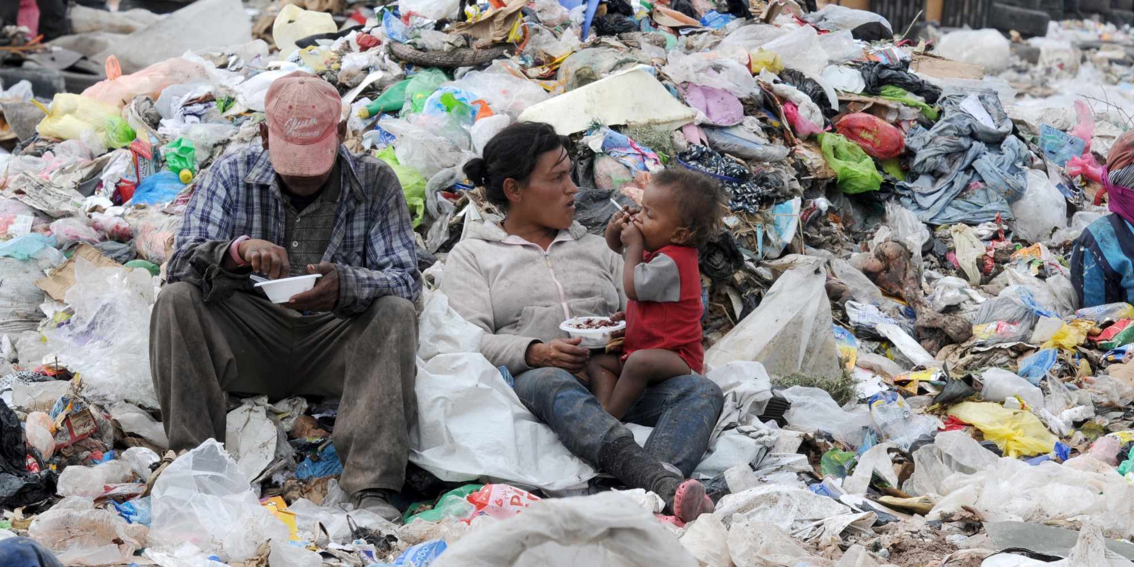

Slide 20
Transportation

Slide 21
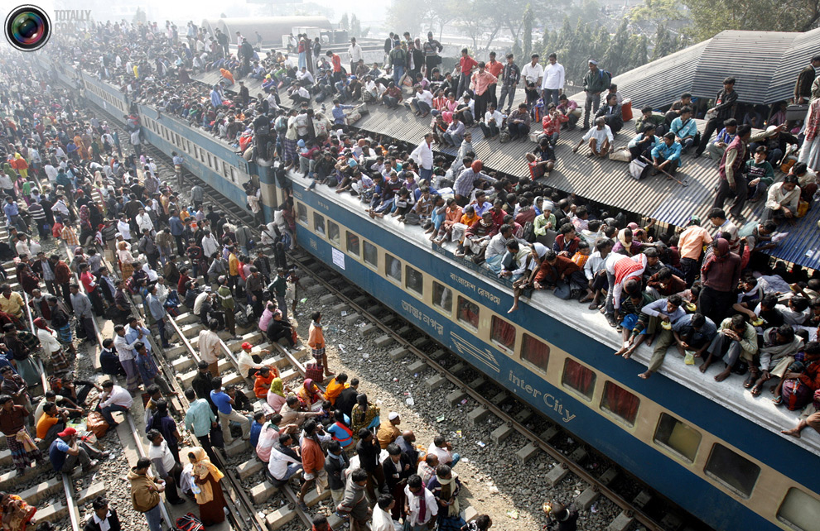

Slide 22
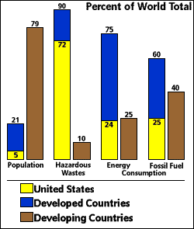
Population and Resource Consumption

